Slide 1
Milestone 3
Timbits
Maksym Zabutnyy, Earl Macalino, Jennifer Herasymuik
February 1st, 2018

Slide 2
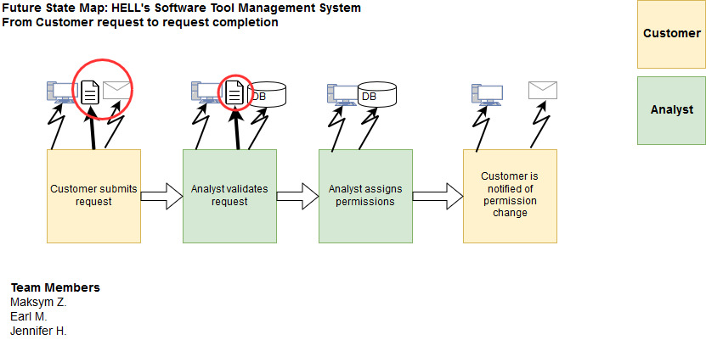
Future VSM
Notes:
Jenn

Slide 3
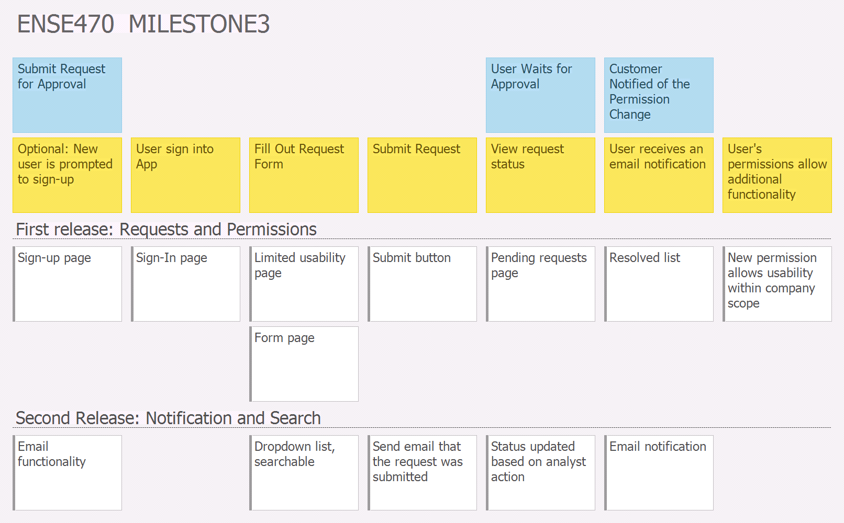
User Story Mapping - Customer
Notes:
Jenn

Slide 4
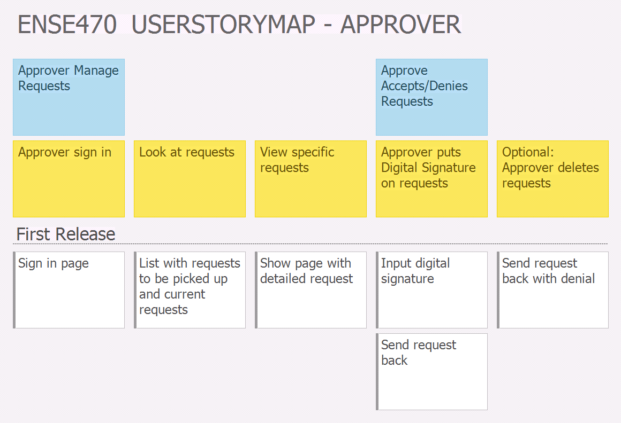
User Story Mapping - Approver
Notes:
Earl

Slide 5
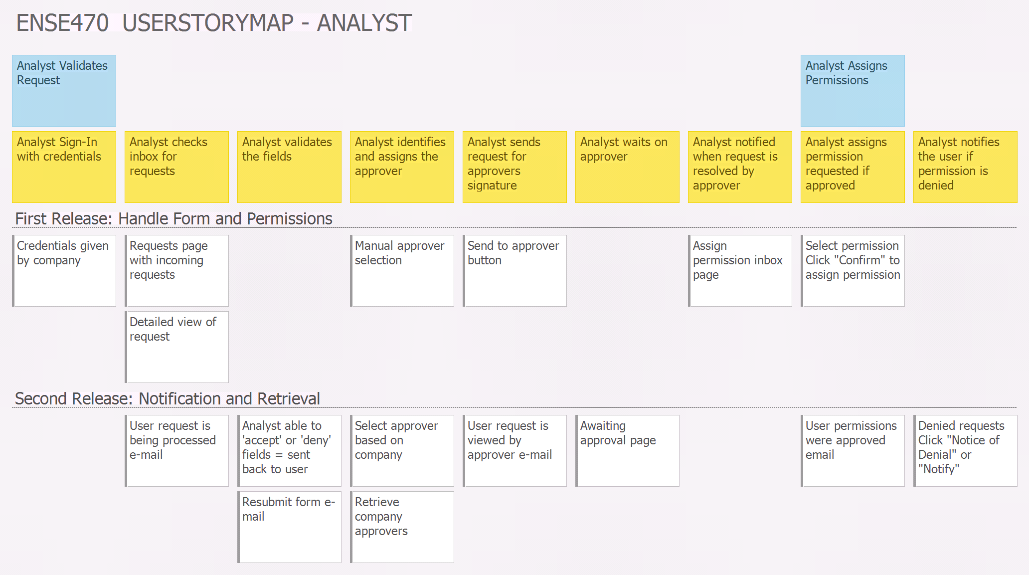
User Story Mapping - Analyst
Notes:
Maks

Slide 6
Changes from Original Design
Expanded on a lot of ideas
Decisions of flow from analyst to approver
Added approver perspective
Adding notification
Approver stories should be done in first release
Selecting/retrieving company/approver functionality
Assigned login credentials
Status updates at any point of the process
Notes:
Maks

Slide 7
Reflection
How did you feel about this milestone? What did you like/dislike about it?
I feel that this is a good visual exercise, i like how this milestone will help us understand different perspective from the different users.
What did you learn about yourself as you collaborated and worked through this milestone?
We learned how to provide a decent visual representation and breaking down large items to smaller item
How will you use what you have learned going forward?
Helps determining functionality for the app when you considering all user’s (approver, analyst, user) perspectives in the user stories.
What “stuff & things” related to this milestone would you want help with?
Who decides which approver for any specific app gets to approve the request.
Notes:
1 and 2 - Earl
3 and 4 - Jenn

Slide 8
Questions?

